Slide 1

Using Bayesian data analysis to model systematics and inform experiment design in Global 21cm experiments
Dominic Anstey
On behalf of the REACH collaboration

Slide 2

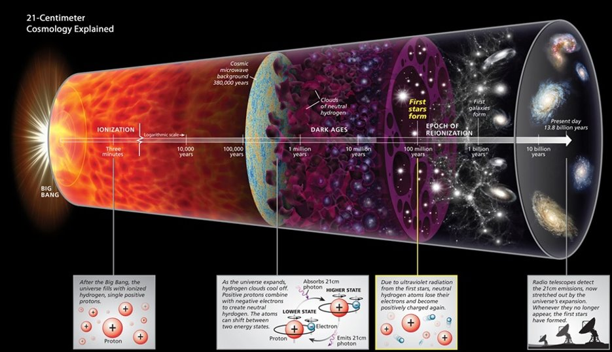
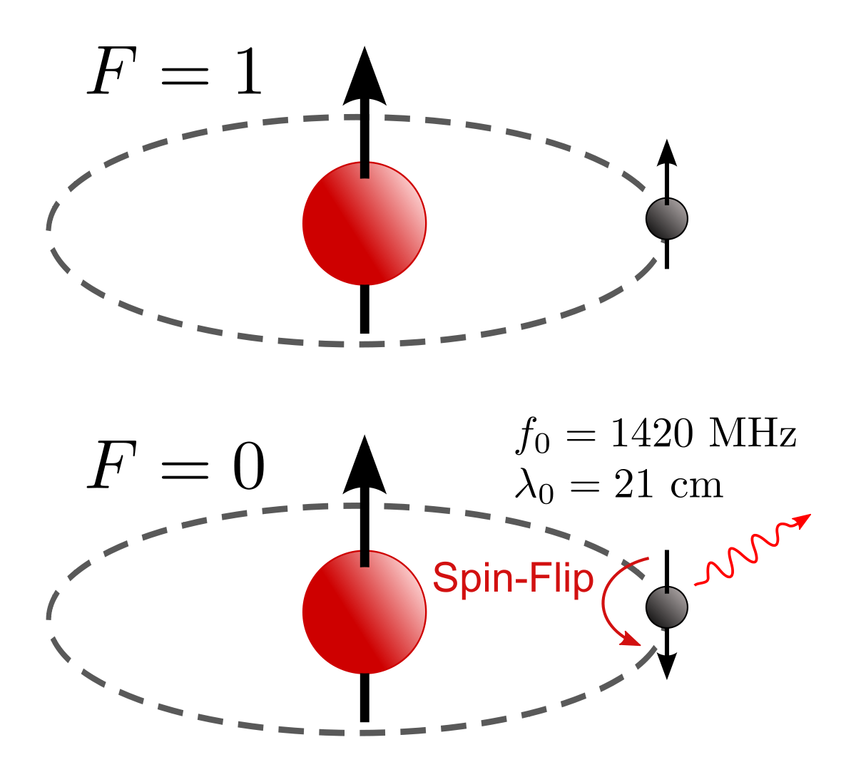
Global 21cm Experiments
https://en.wikipedia.org/wiki/Hydrogen_line
Roen Kelly, Discover Magazine

Slide 3
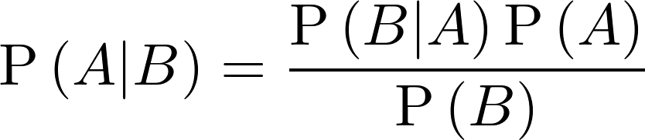
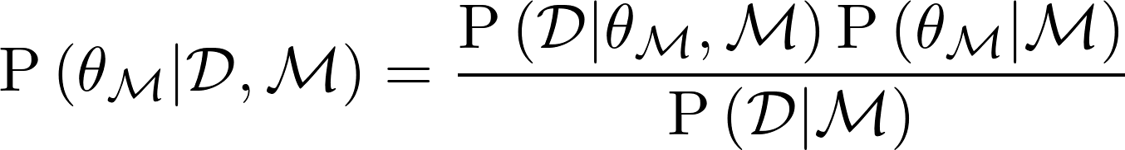
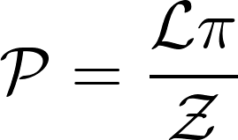
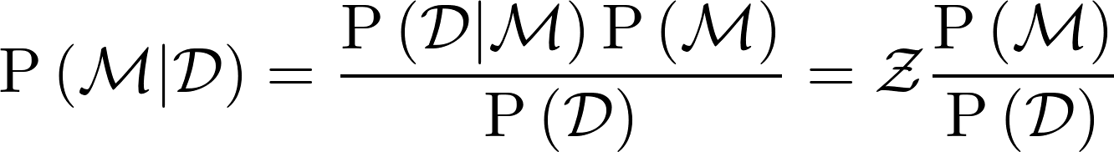
Bayesian Data Analysis

Slide 4


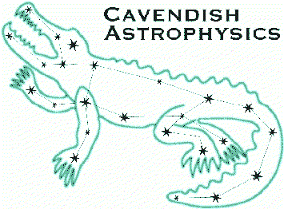















Kavli Institute
for Cosmology
in Cambridge
The Kavli
Foundation
Cavendish
Astrophysics
Stellenbosch
University
National Research Foundation
South African Radio
Astronomy Observatory
Cambridge
University
Imperial
College
Leibniz-Institut für
Astrophysik Potsdam
Groningen
University
Tata Institute for
Fundamental Research
University Carlos III
Madriid
Université catholique
de Louvain
Oxford
University
University of Malta
Rhodes
University
Sussex University

Slide 5
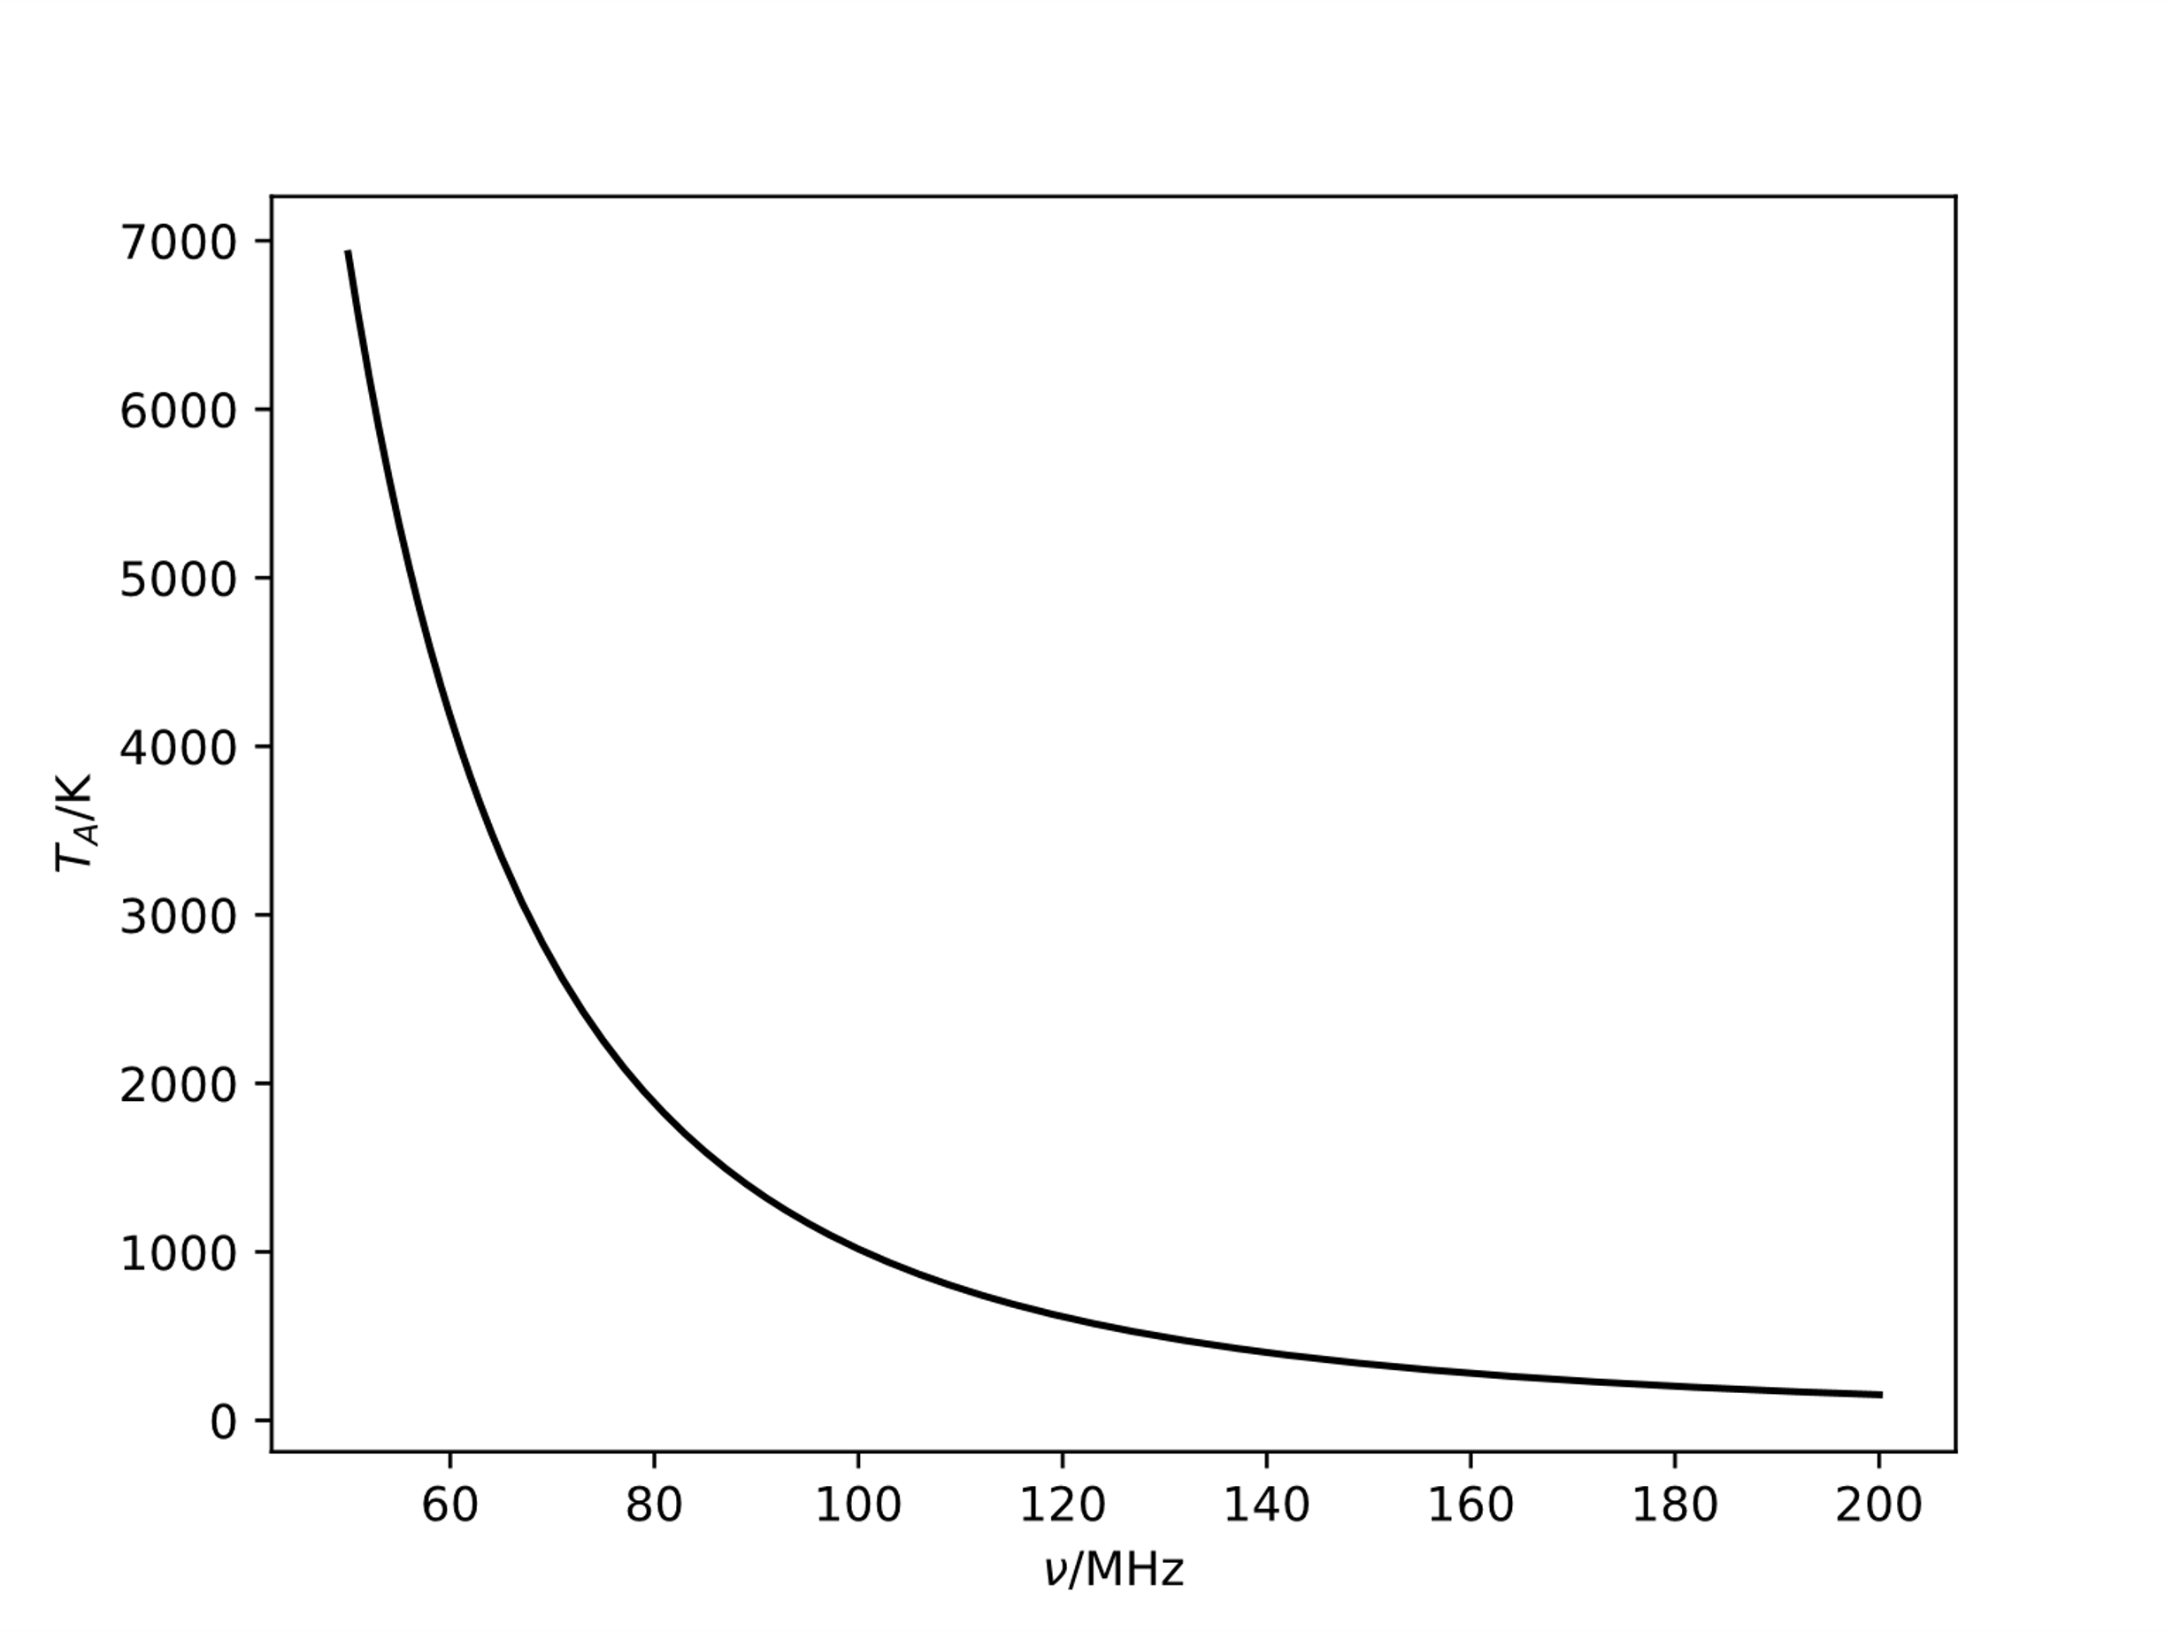

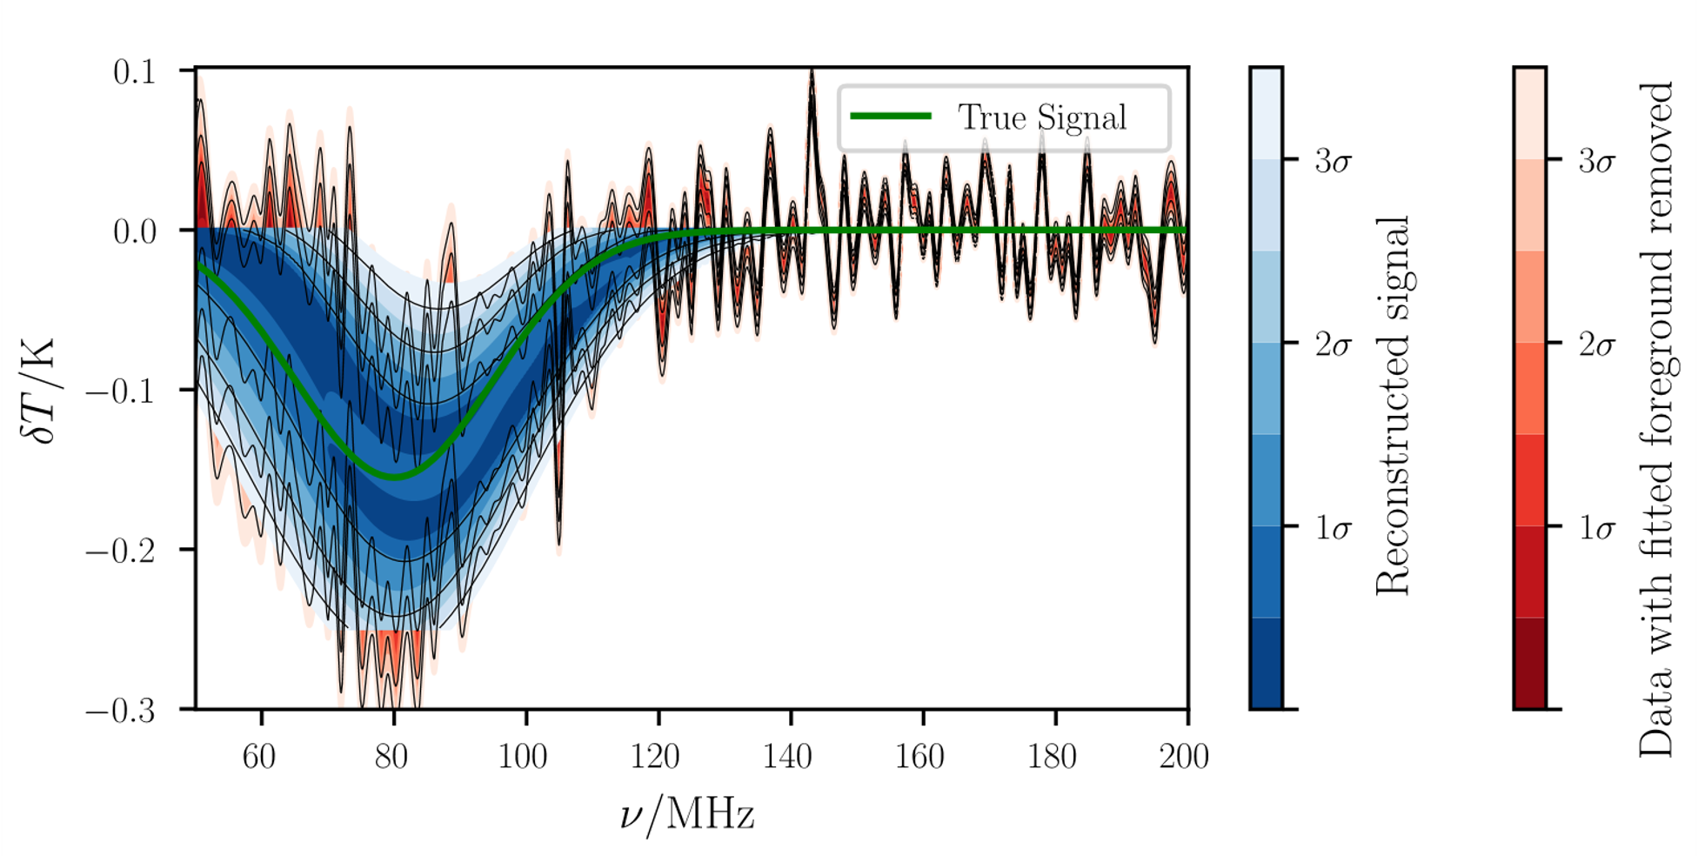
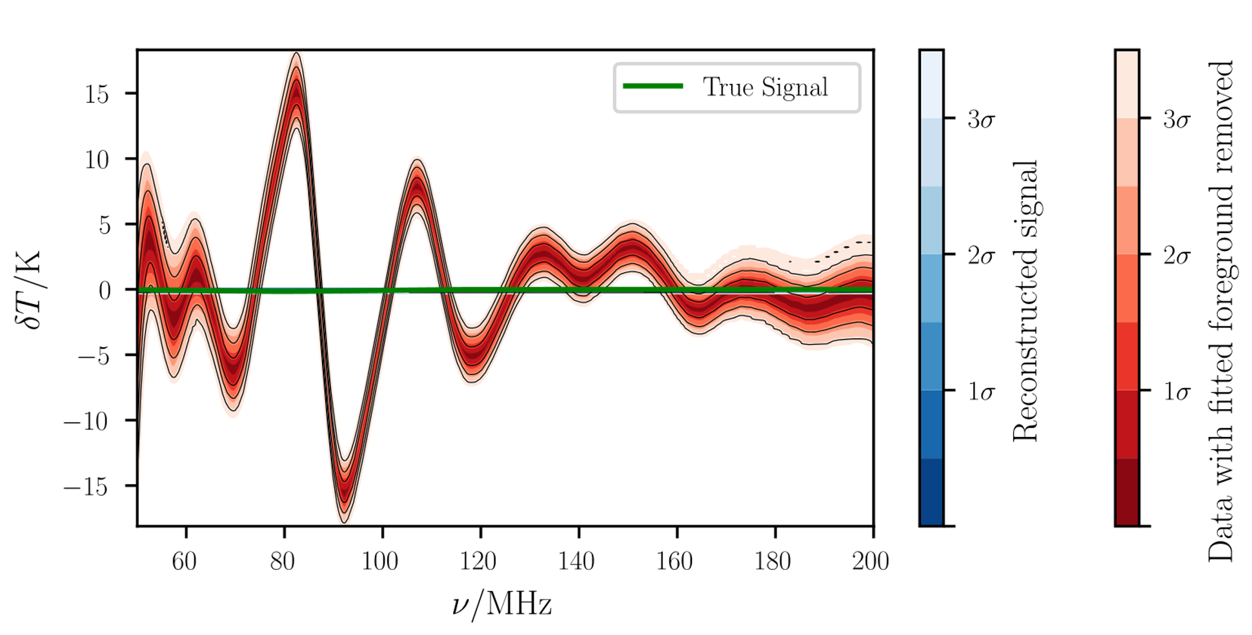
Radio Foregrounds and Chromaticity
Achromatic antenna
Chromatic antenna

Slide 6
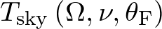
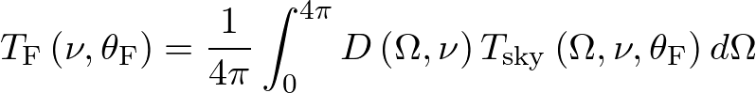
REACH Data Analysis Pipeline
Generate a model of the sky radio emission based on physical parameters
Convolve this with a model of the antenna beam to produce a parameterised foreground model that includes chromatic distortions
Use this model in a Nested Sampling fit
Anstey et al. 2021 (a), arXiv:2010.09644

Slide 7
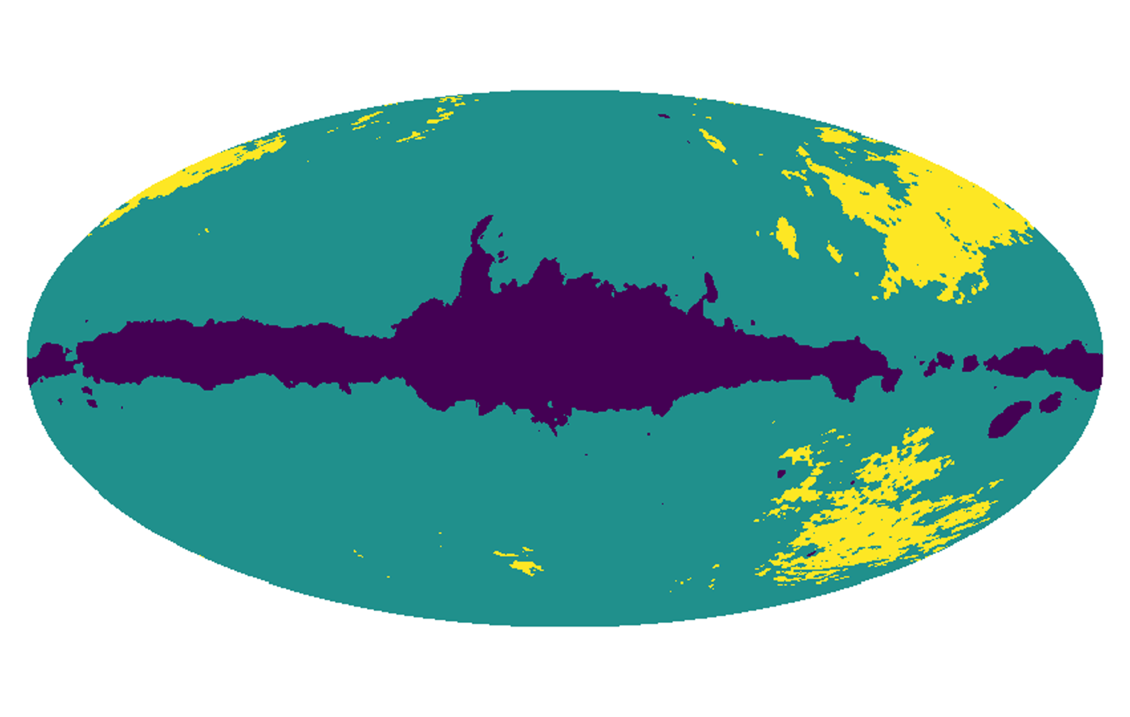
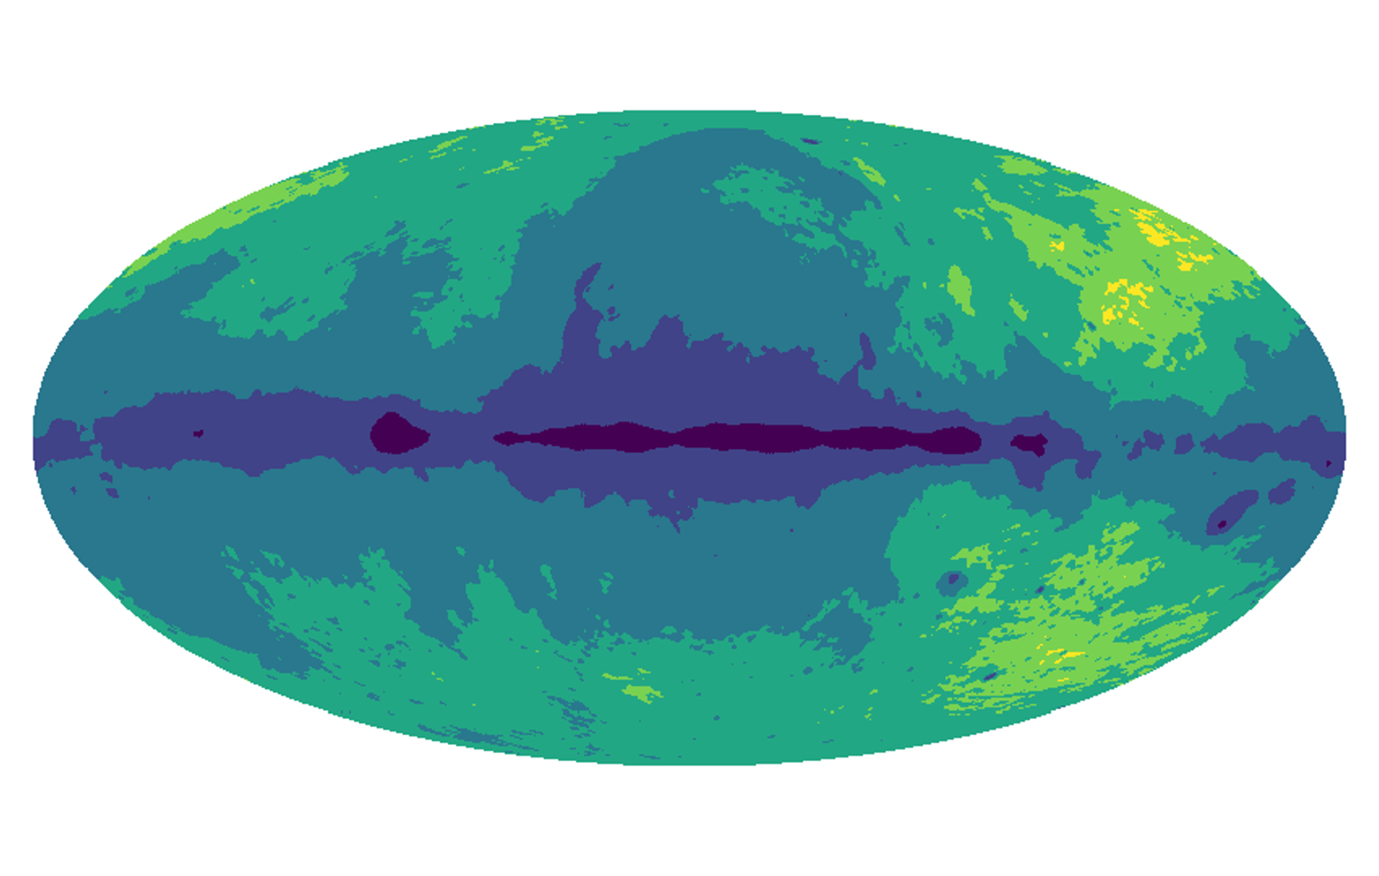
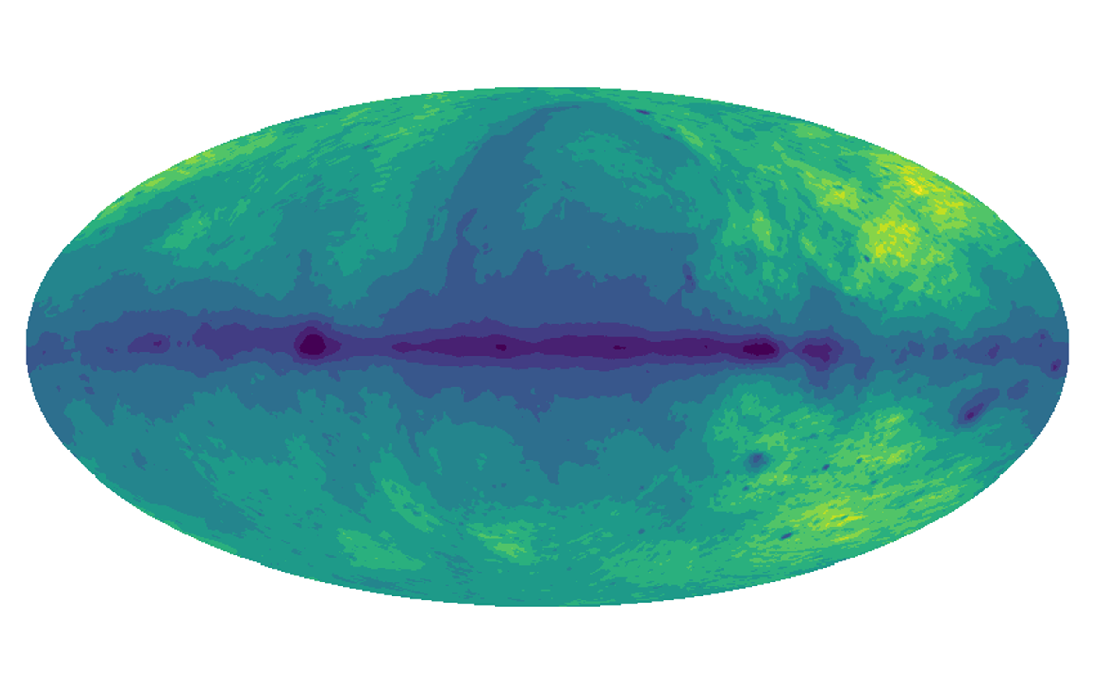
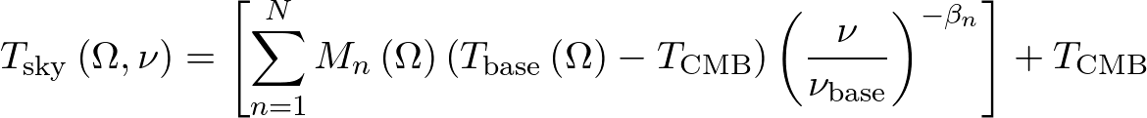
Parameterised Sky Modelling
Parameterise by spectral index
3 Regions
6 Regions
β₆
β₅
β₃
β₄
β₂
β₃
β₁
β₂
12 Regions
β₁
Anstey et al. 2021 (a), arXiv:2010.09644

Slide 8
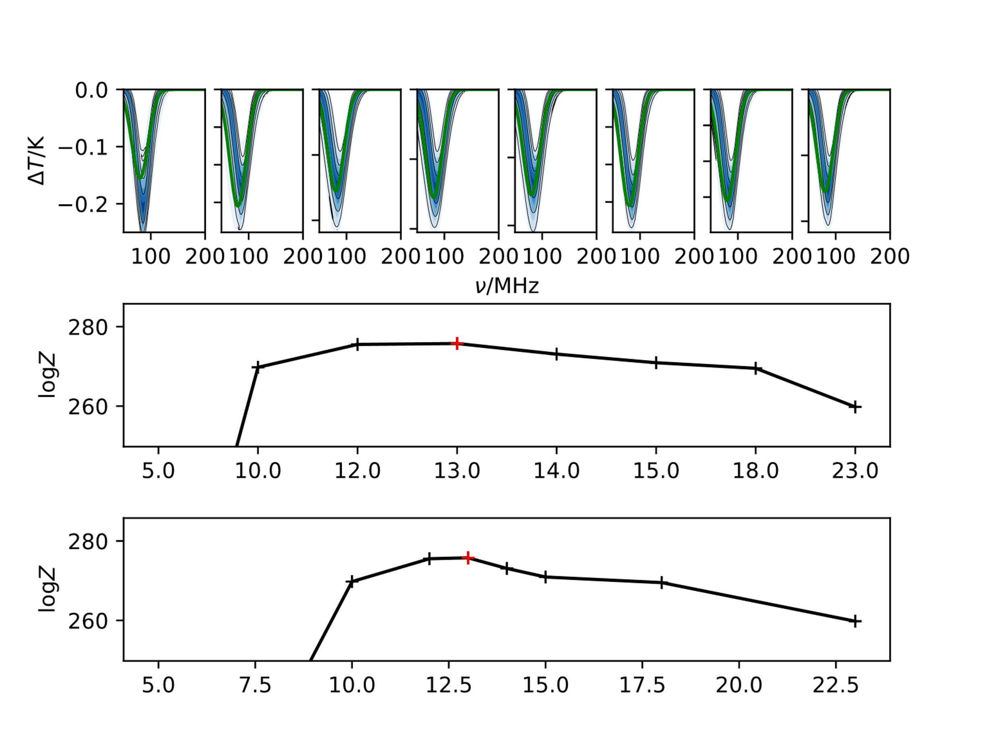
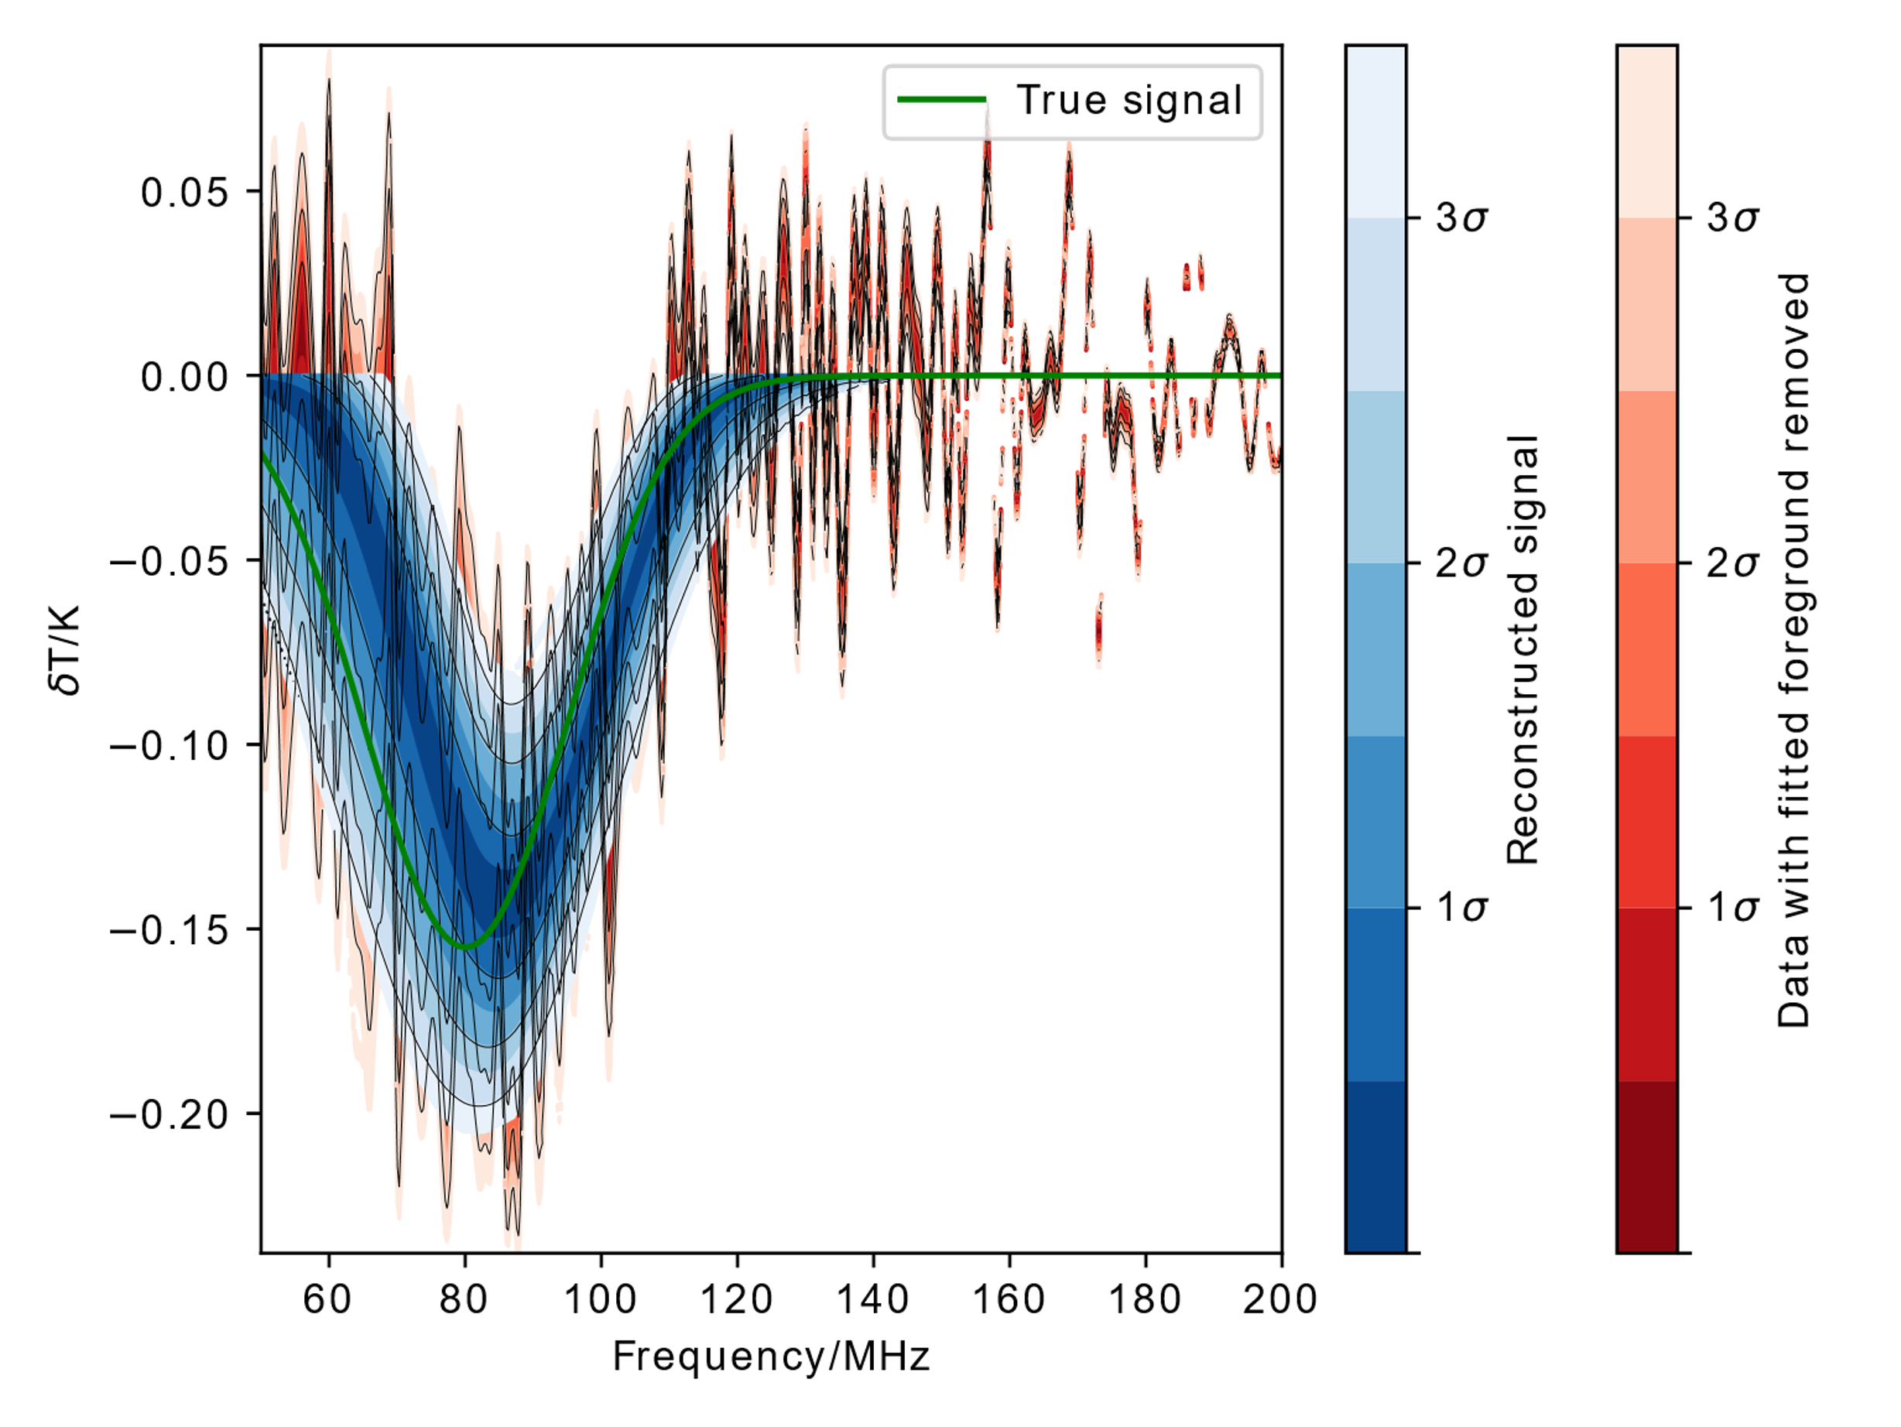
Performance

Slide 9
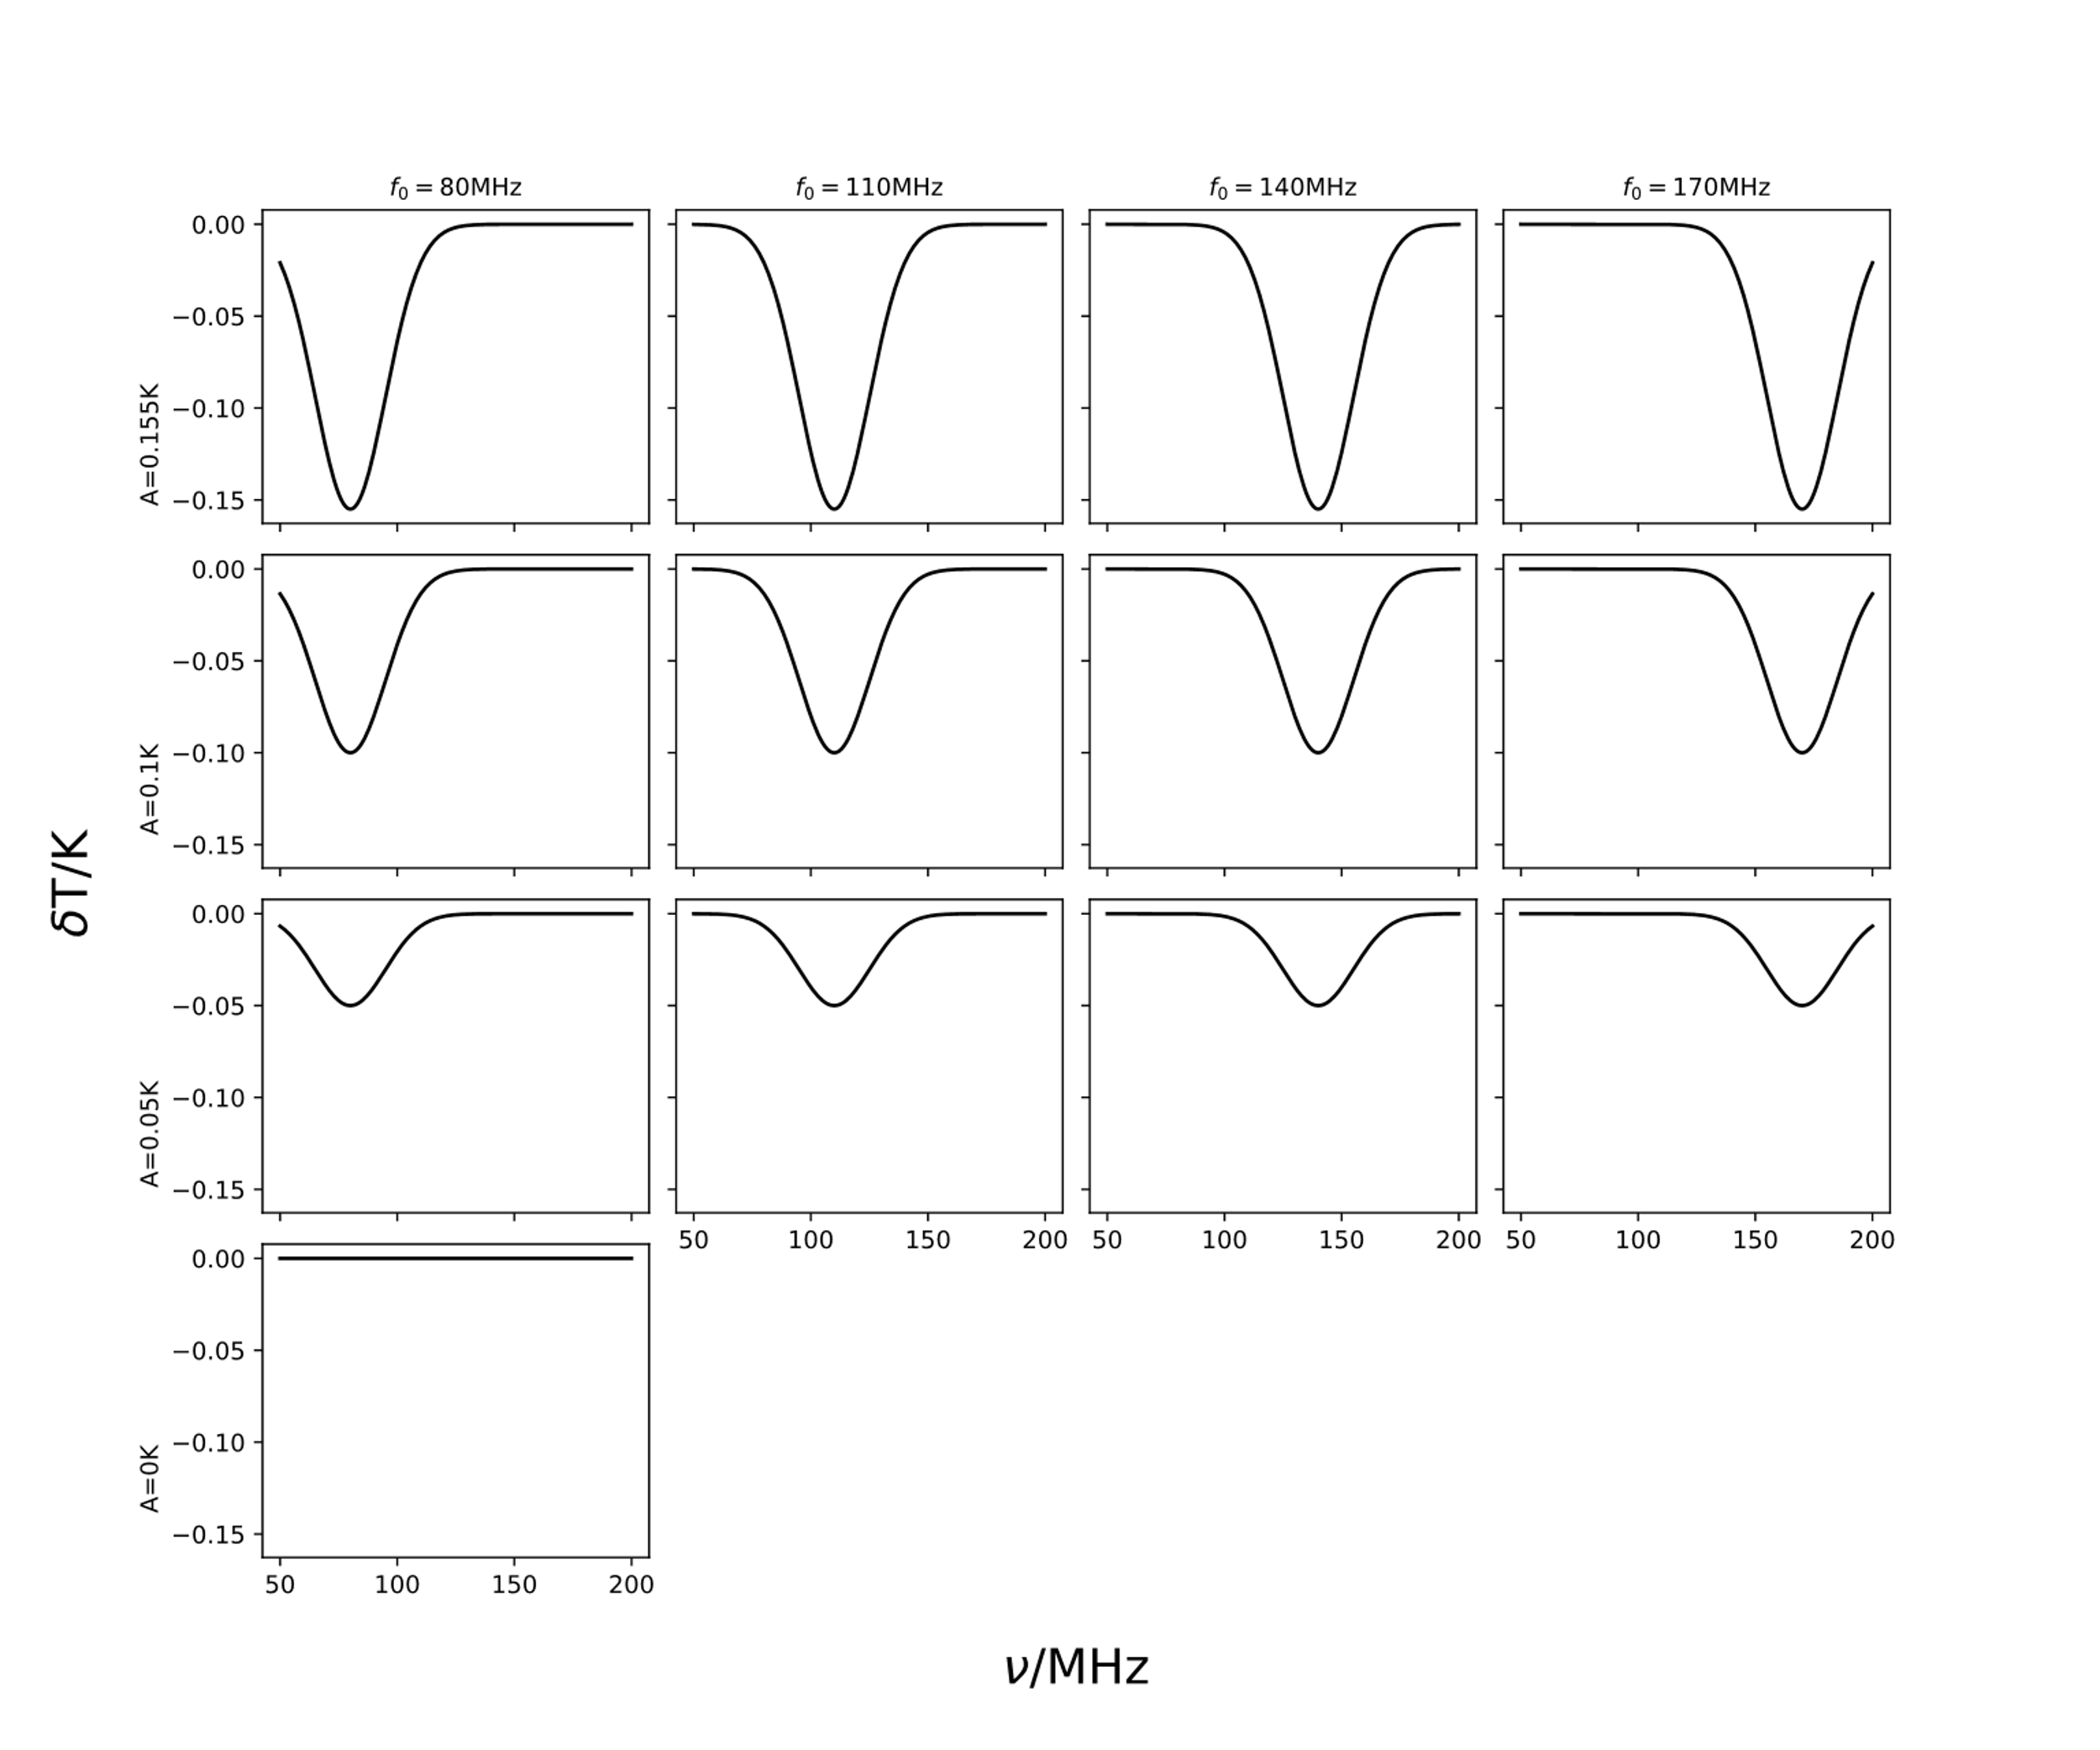
Informing Experiment Design
Simulate observation data for a range of potential antenna designs
Insert a range of mock 21cm signals into the data
Attempt to recover each signal using the described pipeline
This allows the accuracy of each recovered signal to be quantified relative to the true signal. We can also quantify the statistical confidence with which the signal is detected.
Anstey et al. 2021 (b), arXiv:2106.10193 (preprint)

Slide 10
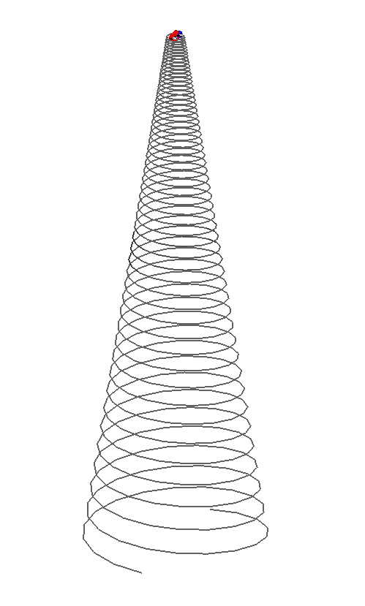
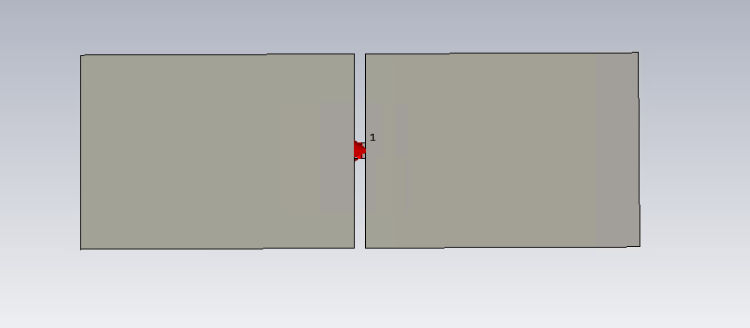
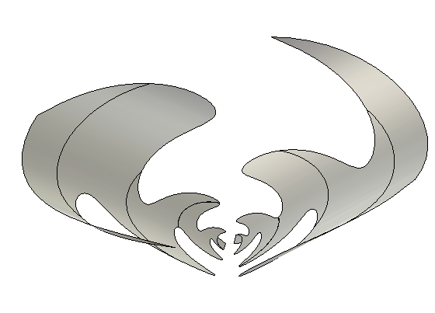
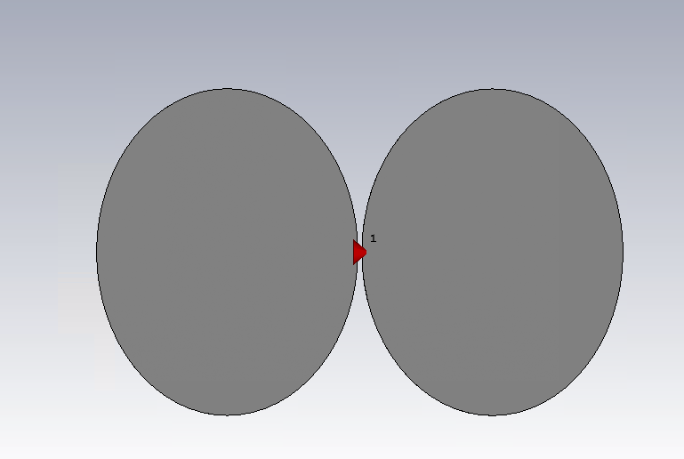
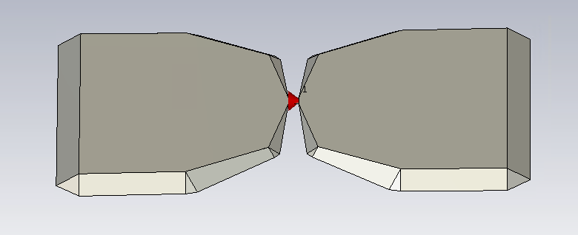
Tested Antennae
Dipoles:
Rectangular
Elliptical
Inverse Conical Sinuous
Conical Logarithmic Spiral
Antenna patterns and images provied by John Cumner and Quentin Guerring
Polygonal

Slide 11
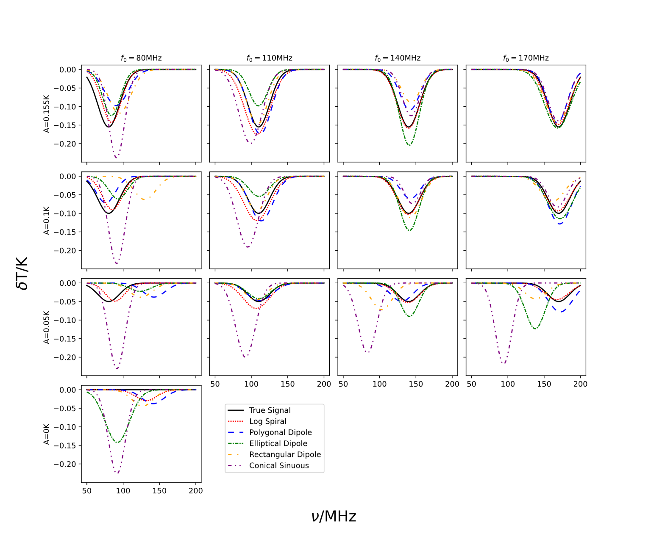
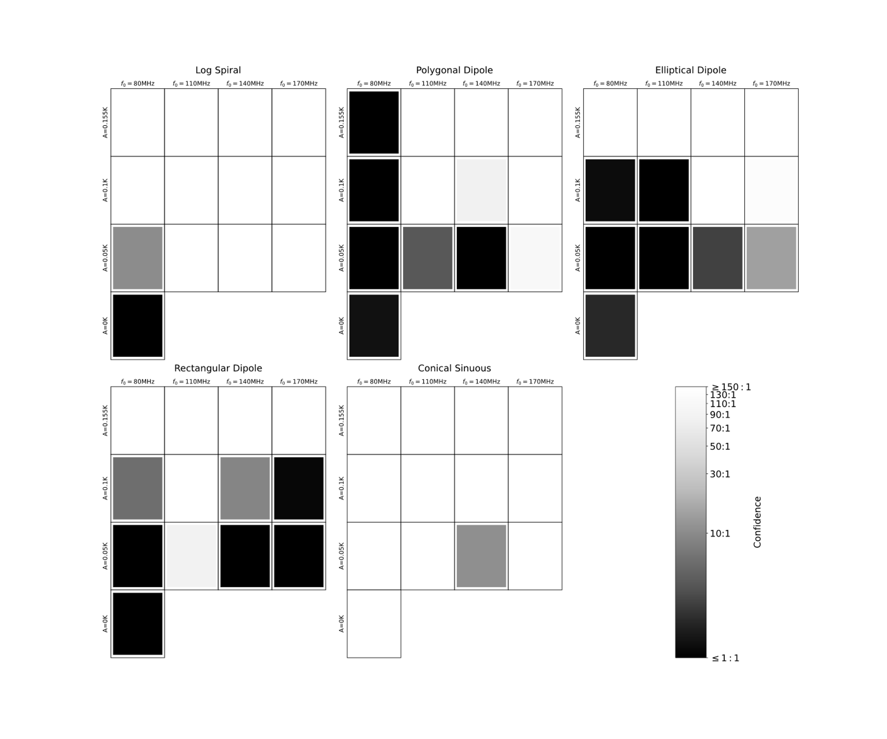
Results
Anstey et al. 2021 (b), arXiv:2106.10193 (preprint)

Slide 12
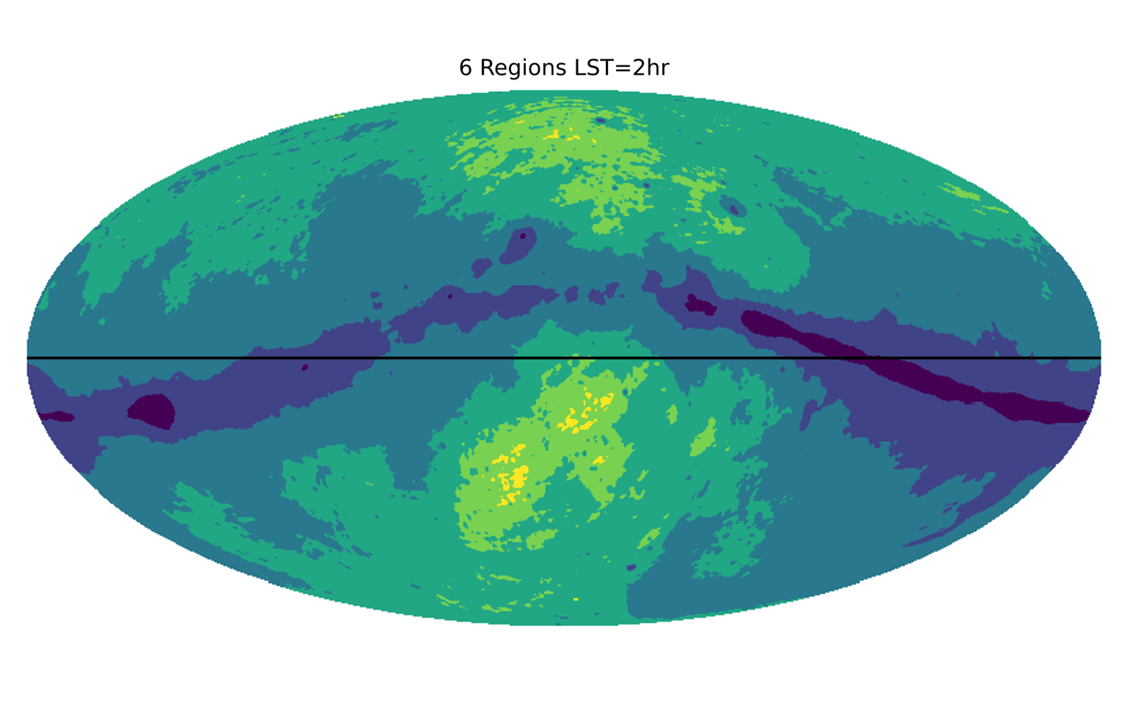
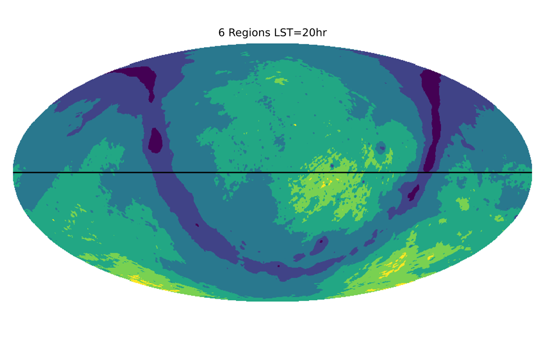
Improving Fit Accuracy
β₁
β₂
_{Etc.}
Horizon

Slide 13
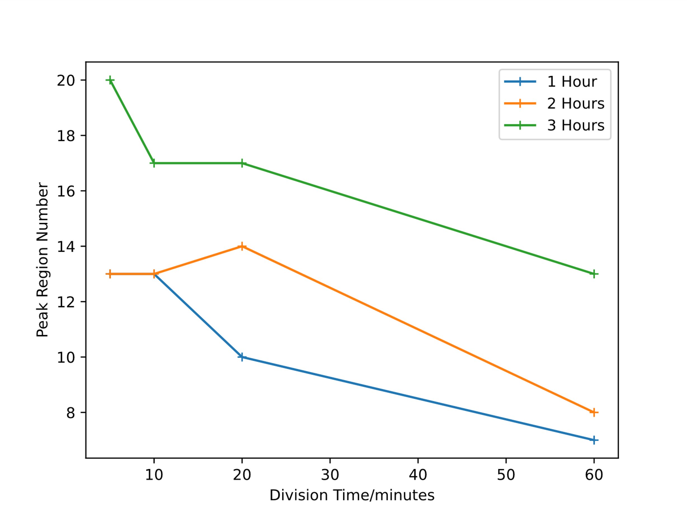
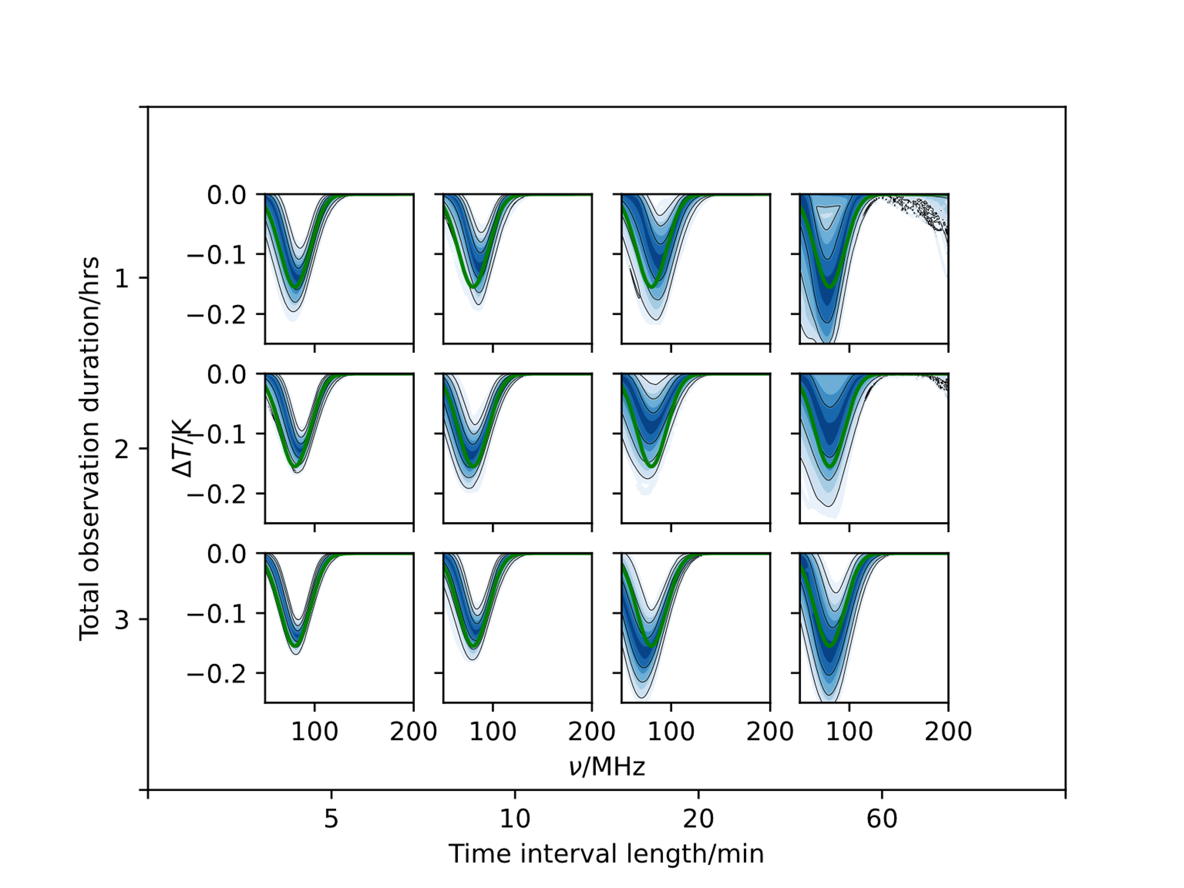
Improving Fit Accuracy

Slide 14




Conclusions
The REACH pipeline uses physical models of foregrounds to correct for chromatic distortions
Analysing simulated data with this pipeline can indicate efficacy of a given antenna in a Global 21cm experiment
Demonstrated this process with 5 example antennae.
Physically motivated parameters allow multiple time-dependent data sets to be fit simultaneously
Demonstrated the improvement in foreground modelling and signal fitting that this provides.
Antenna EM simulations provided by John Cumner and Quentin Gueuning
Plots produced using fgivenx tool: Handley, 2018

Slide 15


